Slide 1
Tech Spotlight: ML Guild Hackathon – Grocery Store Gap Presenters: Swapna Batta and Kaushik Moudgalya

Slide 2


Swapna Batta
Kaushik Moudgalya
Professional Background Worked a lot on Machine Learning and Data Science during Graduation Graduated as an Electronics Engineer Completed 1 year at Deloitte Expertise Oracle EBS and Cloud Application Security ACTT – Automated Controls Testing Tool Fun fact Very fascinated by Japanese and German cultures. Reads: Manga, Manhwa, American Web comics, English Novels. Watches: Cooking Shows, Chinese Dramas, and Anime.
Professional Background Background in Engineering and Business Analytics Senior Data Analytics Specialist Completed 4 years at Deloitte Expertise Design and development of analytic tools/solutions in Audit Analytics Leading analytic projects in various industries - Healthcare, Process & Industrial Products(P&IP) and Financial Services Industry(FSI). Fun fact I enjoy learning Kathak (Indian dance form), playing table tennis and guitar when I get off work. I like reading comics and Medium blog posts

Slide 3
Grocery Store Gap
Names of Team Participants:
Milonee Mehta, Austin Lasseter, Rohit Shah, Swapna Batta, Kaushik Moudgalya
Problem Description:
How can state governments effectively allocate their limited resources to fight food insecurity and diet-related illnesses?
Solution Description:
A Predictive Health Dashboard which will help state governments find a way to adequately allocate their limited resources for fighting food insecurity and diet-related illnesses.
Technologies and Platform Used:
Google Cloud Platform, Plotly Dash and Python

Slide 4

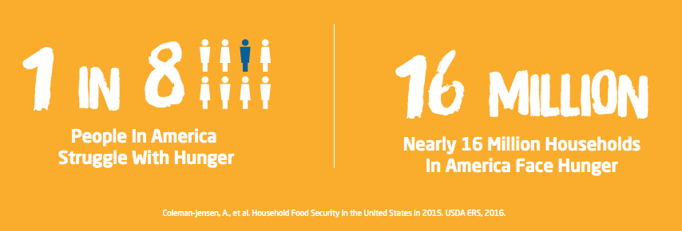
The Problem
Millions of Americans are food insecure
Source:
Feeding America: Understanding Food Insecurity
Daily Herald: Poor neighborhoods struggle without supermarkets
CDC: National Diabetes Statistics Report
Mashable: Supermarket chains avoid low-income neighborhoods
Feeding America: Western Michigan
The Food Insecurity Spiral

Slide 5



Current Solution to the Problem
What do state governments rely on to fix this problem?
SNAP Food Banks Emergency Food Providers
Source:
SNAP
Food Bank
TEFAP

Slide 6
Our Solution
“Predictive Health Dashboard”, which would allow state governments to assess the health of their constituents, as well as take action to halt the spread of diet-related illnesses. It has 2 separate machine learning models.
Model 1: Diagnose the problem.
Predicts the probability that a county experiences a diabetes rate greater than the national average.
Model 2: Take proactive action
Predicts the probability that a county will experience a decline in the number of grocery stores over the next 5 years.
Notes:
The rest will be covered in the demo.

Slide 7
Our Solution
How did we build our solution?
Data Search & Extraction
Data Preparation & Manipulation
Model Build-out
Main Source of Data
Additional data
Feature scaling
Diabetes Prediction Model
Used Random forest model to predict whether or not the rate of diabetes in a certain county will be above the national average
Data preparation
Consolidating data sources
Exploratory Data Analysis
Feature selection techniques based on observed correlations and intuition
USDA Food Environment Atlas
USDOC Bureau of Economic Analysis
Feature Engineering
Grocery Store Decline Model
Data imputation
Used Neural Network model to predict whether or not a county will experience a decline in grocery stores over the next five years.
Target variable creation

Slide 8
How does our solution work?
Open Local App.
Notes:
This is our version of the Web App Demo.

Slide 9
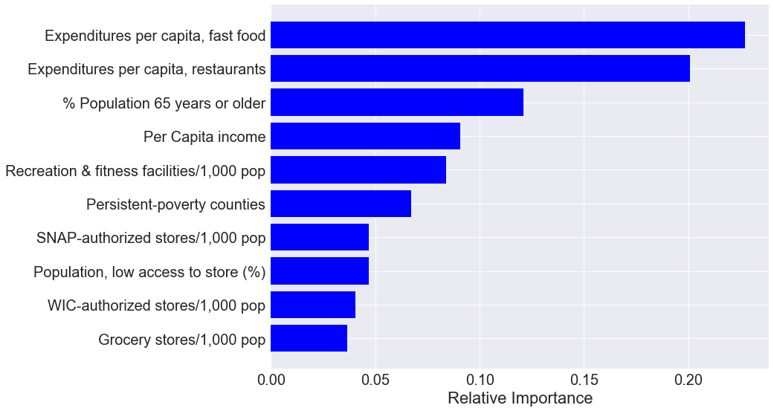
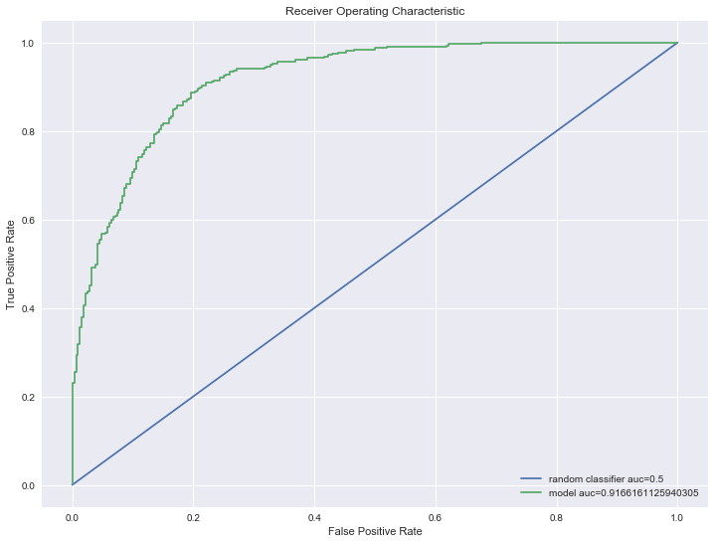
Model 1: Is it possible to know which US county experiences a diabetes rate greater than the national average without collecting any PHI(Protected Health Information)?
Random Forest model
Accuracy: 82.8%
AUC: 91.6%
Feature Importance

Slide 10
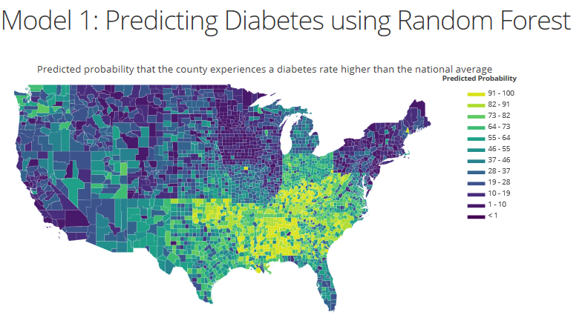

Slide 11
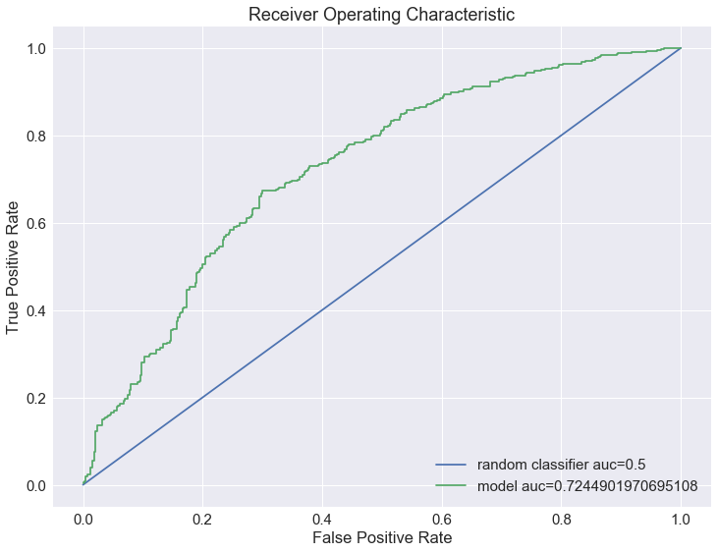
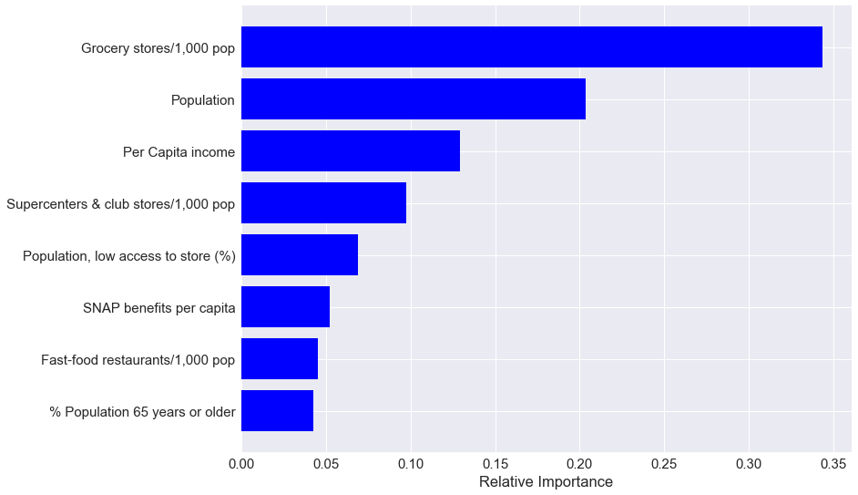
Model 2: Which US counties are likely to experience a decline in grocery stores over the next five years?
Random Forest model
Accuracy: 67%
AUC: 72%
Feature Importance

Slide 12
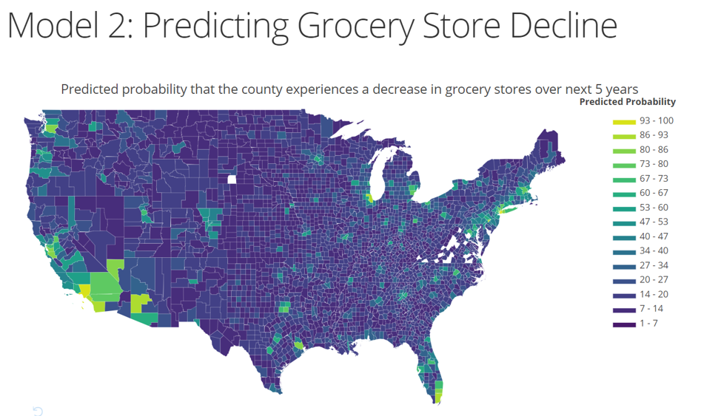

Slide 13

Market Opportunity
DIABETES & OBESITY RATE
ACCESS TO STORES
PII
PHI
PROXIMITY TO KEY MARKETS
GROCERY STORE SUCCESS
Sources:
Supermarkets and Grocery Stores – US Market research - https://www.ibisworld.com/industry-trends/market-research-reports/retail-trade/food-beverage-stores/supermarkets-grocery-stores.html
Grocery Sales influenced by the Digital Along the Path to Purchase - https://www2.deloitte.com/us/en/pages/about-deloitte/articles/press-releases/deloitte-survey-grocery-reaches-digital-tipping-point.html
Associations of supermarket accessibility with obesity and fruit and vegetable consumption in the conterminous United States - https://ij-healthgeographics.biomedcentral.com/articles/10.1186/1476-072X-9-49
http://pro4ma.com/2018/03/29/data-driven-decision-making-is-fundamental-2/
https://www.amazon.com/Whole-Foods-Market-Inc/dp/B01IDLQKJM

Slide 14
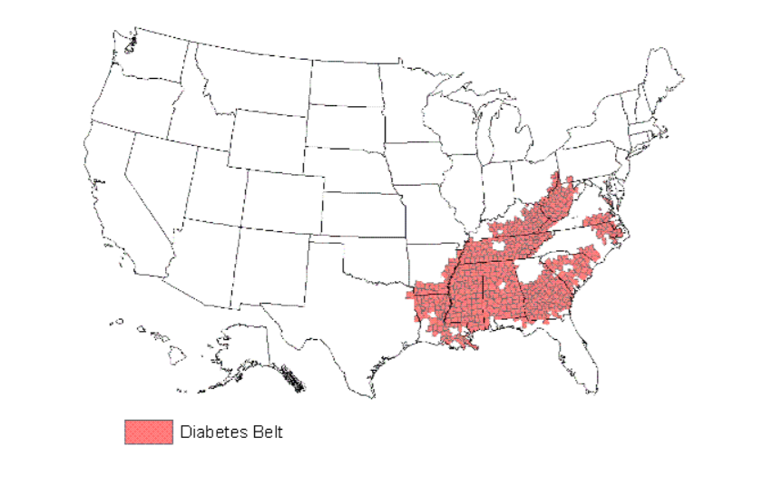
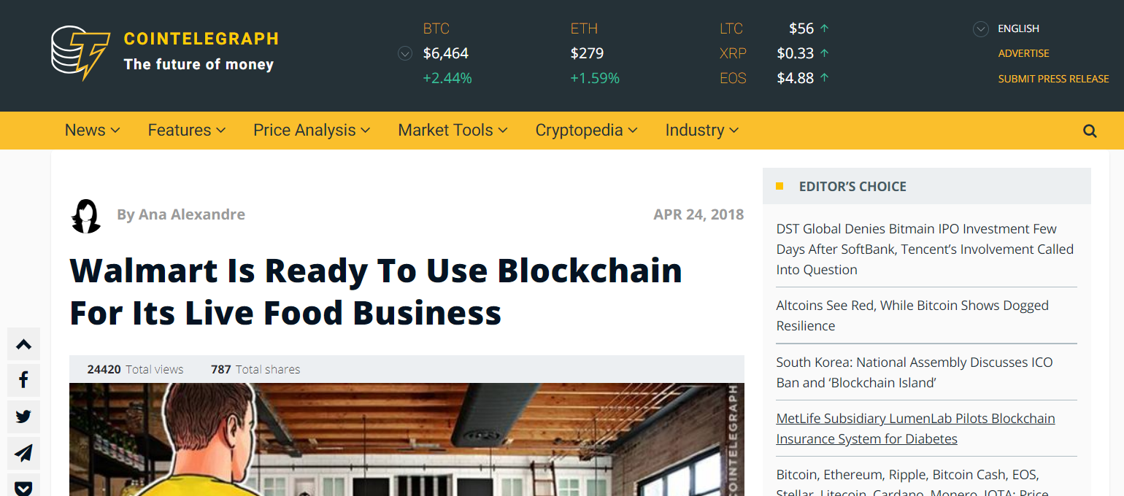

Client Opportunities for Deloitte
Our Proof-of-Concept provides a solution that could tie in well with Deloitte’s new Government & Public Service offering by combining our ML expertise with our experience with state government consulting.
Worldwide
Future of Retail
Not only the US, but also the UK faces two pronged epidemic of Diabetes and Obesity. Proper establishment and placement of Grocery Stores in developed and developing countries could be a game changer to solve the obesity and diabetes issues.
Machine Learning and Blockchain could be exactly what the doctor ordered for an industry where there is a lot of scope for experimentation and improvement. For instance, Amazon Go.

Slide 15
Conclusion
This model is a decision making aid and not a decision maker.
Clients (State Governments) can choose to use money to:
Offer a tax incentive to keep stores open
(or)
Run a nutrition awareness campaign
Right allocation of resources now leads to greatest impact in the future!

Slide 16
Thank You!

